Slide 1

The Test Data Factory Project, PhUSE Standard Analyses Working Group
TAP TO RETURN TO KIOSK MENU
The TDF project team updated data packages based on Study Data Tabulation Model (SDTM) and Analysis Data Model (ADaM) databases, and including Case Report Tabulation Data Definition Specification (CRT-DDS, define.xml) documentation, originally published for a CDISC Pilot Project.
The TDF team is now implementing SAS and R code to simulate clinical trial data from user configuration.
PhUSE is a volunteer organization that relies on community contribution to progress initiatives such as TDF. This poster and paper inform the community of TDF history, current activities, and future plans. We further hope to inspire interested programmers and software developers to join our efforts and be a part of delivering these capabilities to our industry.
Test Data Factory (TDF) is one of seven projects within PhUSE’s Standard Analyses and Code Sharing Working Group (SACS).
Suitable test data are an essential part of software development and testing.
The objective of the TDF project is to provide up-to-date, CDISC-compliant test data to empower statistical programmers and software developers.
Users, primarily software developers and quality control staff, should be able to customize fundamental aspects of test databases.

Slide 2
The Test Data Factory Project, PhUSE Standard Analyses Working Group
In 2007, CDISC published a CDISC Pilot Project submission package.
In 2013, CDISC updated their Pilot Project.
In 2018, the TDF team updated the 2013 CDISC pilot data packages
The TDF team published two test data packages based on CDISC pilot data
31 SDTM data sets
SDTM IG Version 3.2, and SDTM Model Version 1.6
12 ADaM data sets
ADaM IG Version 1.1, and ADaM Model Version 2.1
Including define.xml files
Published in Github repo
Standard Analyses & Code Sharing
Test Dataset Factory: TDF_SDTM: SDTMIG v3.2 Test Datasets (PDF). SDTM zip file. 07-Dec-2018.
Test Dataset Factory: TDF_ADaM: ADaMIG v1.1 Test Datasets (PDF), ADaM zip file. 07-Dec-2018.

Slide 3
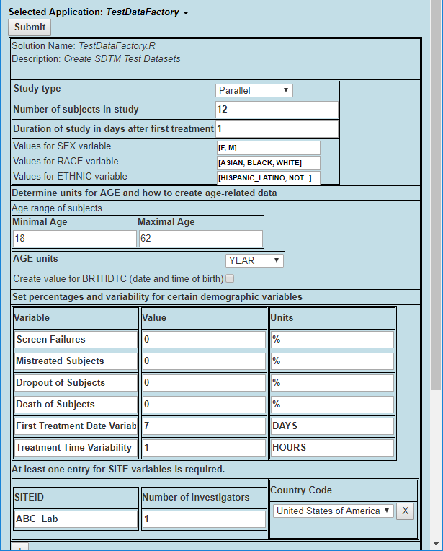
The Test Data Factory Project, PhUSE Standard Analyses Working Group
Next steps: Develop a framework and syntax, so users can easily describe a credible clinical study test database
Variable Modeling: User configuration and TDF simulation of variable types, such as numeric, date/time, controlled terminology
User Interface: Trial Design Matrix Excel workbook vs. Web interface. See concept 
TDF project provided CDISC test databases, an important contribution to the development of CDISC-based software solutions.
An open, interactive software platform that delivers users with customized test databases remains an appealing objective.
We welcome your contributions to achieve these goals.

